Slide 1
Bootstrap for neural model selection
Author: Riadh Kallel, Marie Cottrell, Vincent Vigneron
------MATISSE-SAMOS, Universite Paris

Slide 2
Bootstrap for
neural model selection
1
【Introduction】
2
【Multilayer Perceptrons (MLP)】
3
【Bootstrap for parameter estimation】
4
【Bootstrap applied to selection model for MLPs】
5
【Results】
6
【Conclusion】

Slide 3
Introduction
Bootstrap is a method for assigning measures of accuracy to sample estimates. It allows estimation of the sampling distribution of almost any statistic using only very simple methods.
The statistics computed on the generated data sets give a good idea of the confidence regions of the estimates.
In this paper, the author debate on the contribution of bootstrap for model selection, in the case of feedforward neural networks.
Notes:
5

Slide 4
Situations where bootstrap is useful
When the theoretical distribution of a statistic of interest is complicated or unknown.
When the sample size is insufficient for straightforward statistical inference.
When power calculations have to be performed, and a small pilot sample is available.

Slide 5
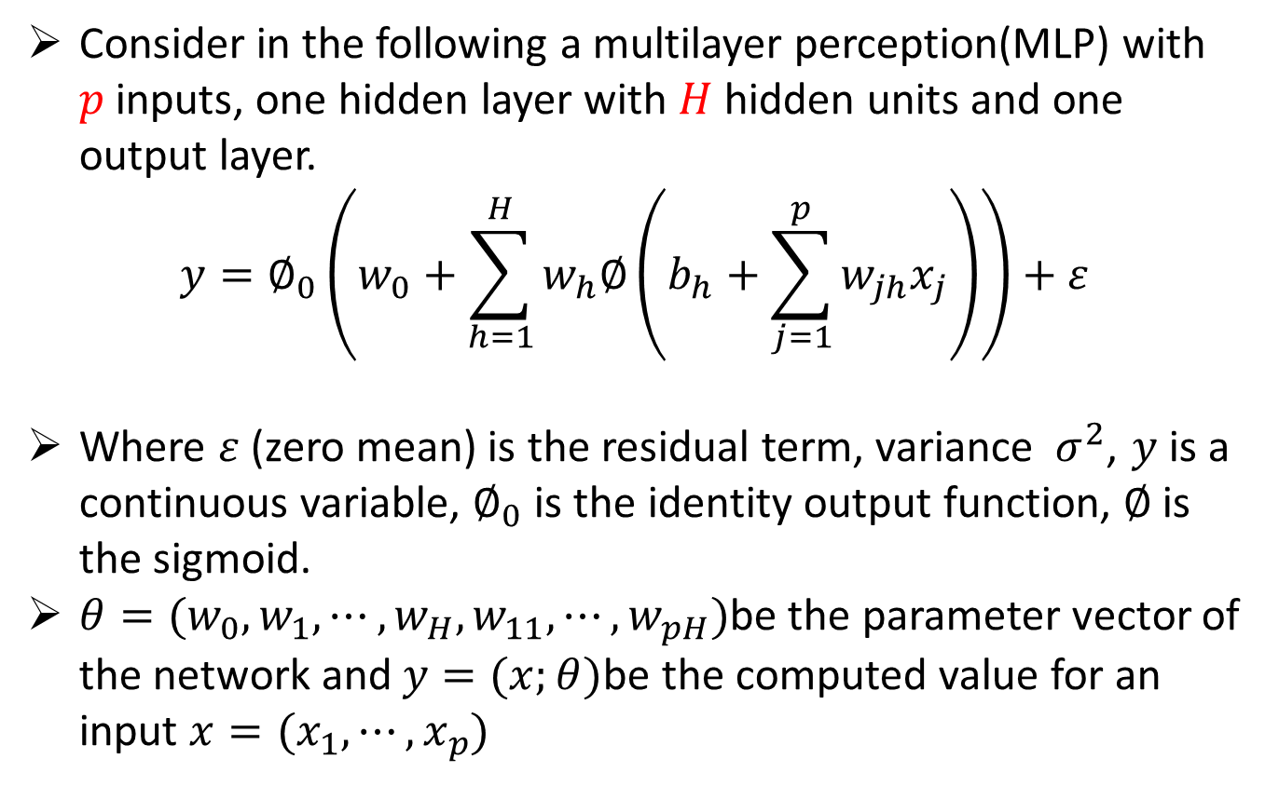
Multilayer Perceptrons (MLP)
Consider in the following a multilayer perception(MLP) with $p$ inputs, one hidden layer with $H$ hidden units and one output layer.
$$y=∅_{0}\left(w_{0}+\sum_{h=1}^{H}{w_{h}∅\left(b_{h}+\sum_{j=1}^{p}{w_{jh}x_{j}}\right)}\right)+ε$$
Where $ε$ (zero mean) is the residual term, variance $σ^{2}$, $y$ is a continuous variable, $∅_{0}$ is the identity output function, $∅$is the sigmoid.
$θ=(w_{0},w_{1},⋯,w_{H},w_{11},⋯,w_{pH})$be the parameter vector of the network and $y=(x;θ)$be the computed value for an input $x=(x_{1},⋯,x_{p})$

Slide 6
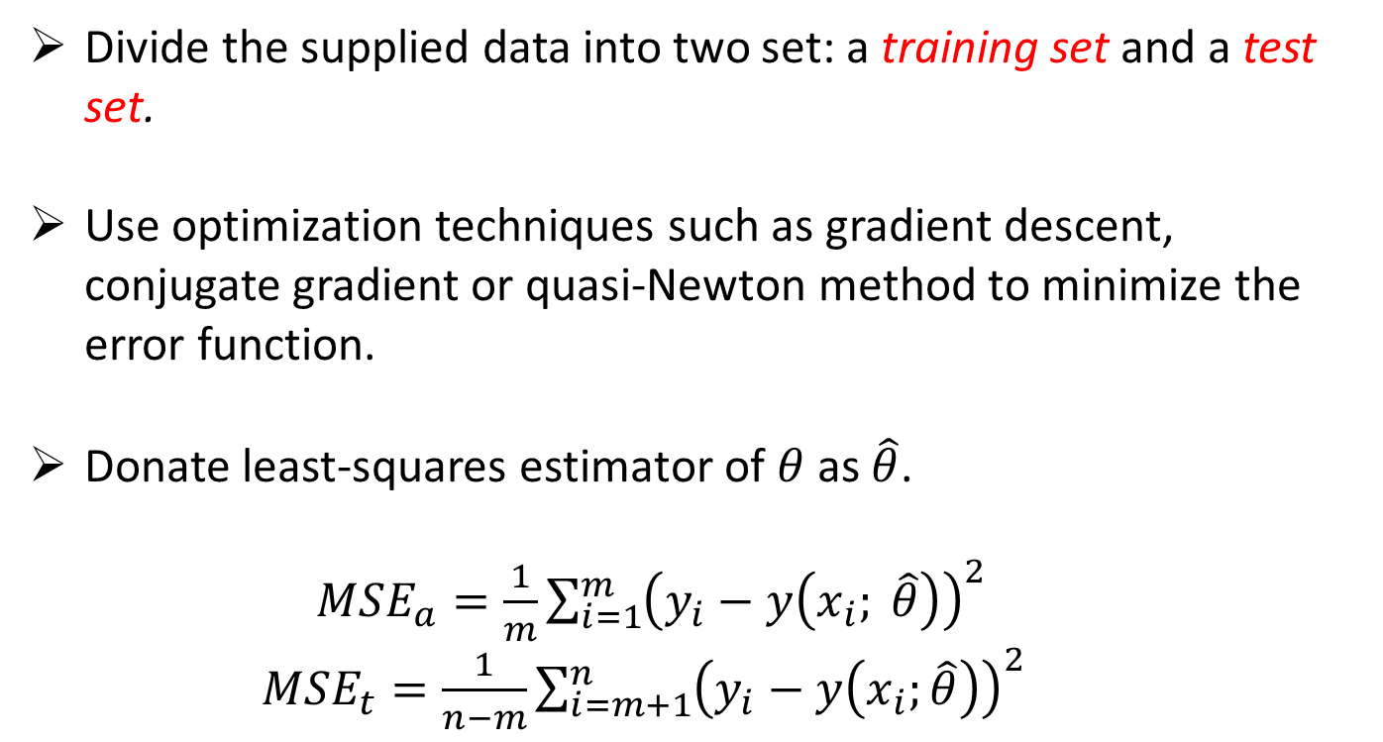
Multilayer Perceptrons (MLP)

Slide 7
Bootstrap for
parameter estimation
The basic idea of bootstrap is that inference about a population from sample data (sample -> population) can be modeled by resampling the sample data and performing inference on (resample -> sample).
More formally, the bootstrap works by treating inference of the true probability distribution J, given by the original data, as being inference of the empirical distribution of Ĵ, given by the resampled data. The accuracy of inferences regarding Ĵ using the resampled data can be assessed because we know Ĵ.

Slide 8
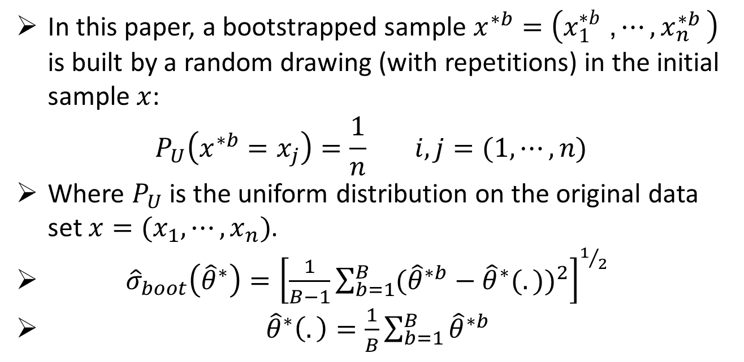
Bootstrap for
parameter estimation

Slide 9
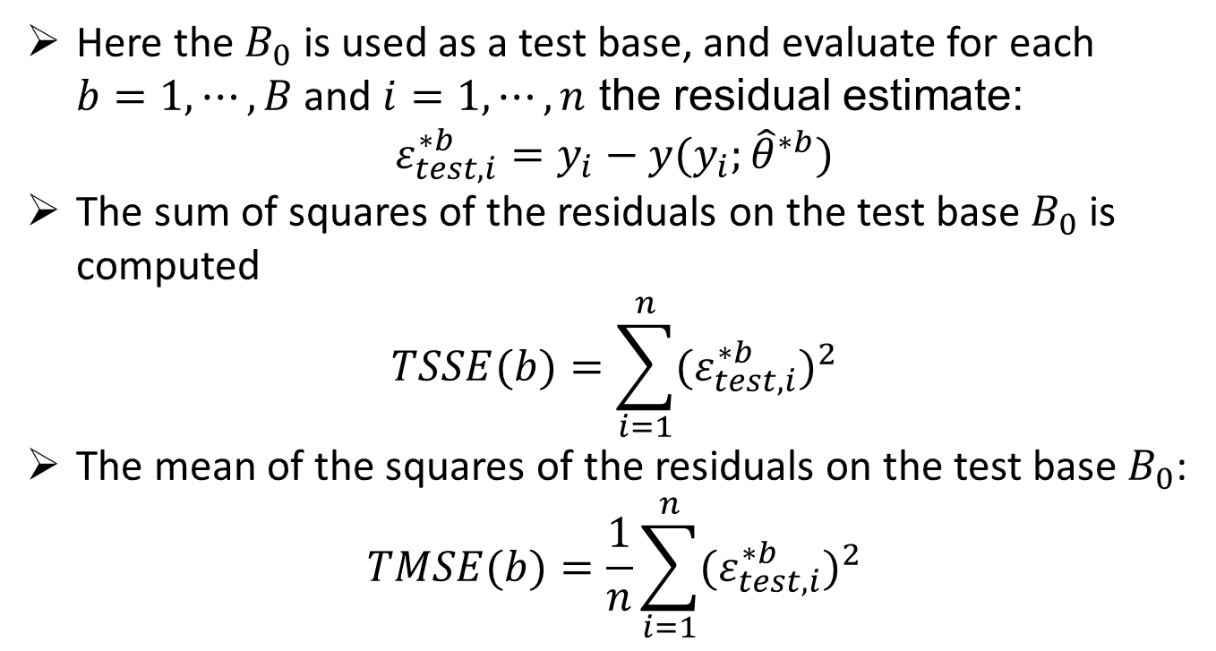
Bootstrap applied to
Selection model for MLPs

Slide 10
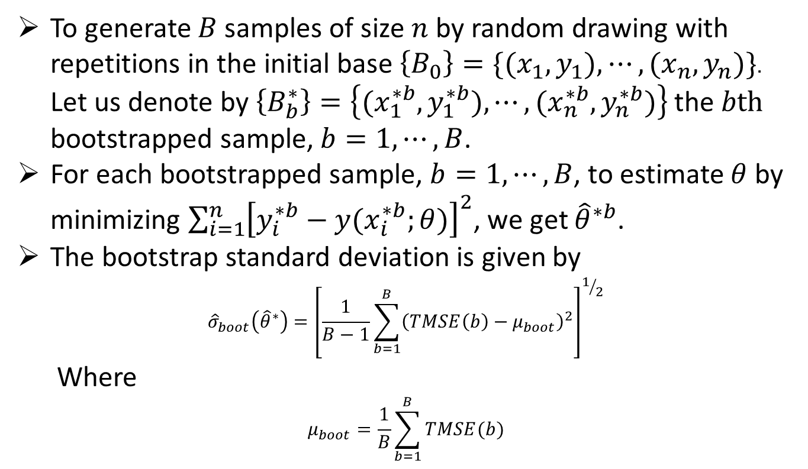
Bootstrap applied to
Selection model for MLPs

Slide 11
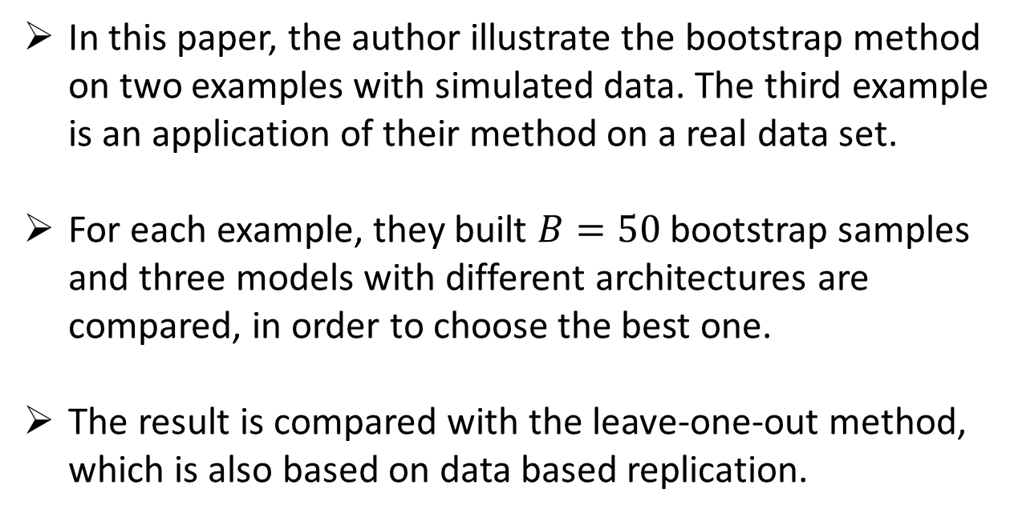
Results
In this paper, the author illustrate the bootstrap method on two examples with simulated data. The third example is an application of their method on a real data set.
For each example, they built $B=50$ bootstrap samples and three models with different architectures are compared, in order to choose the best one.
The result is compared with the leave-one-out method, which is also based on data based replication.

Slide 12
Results
Model |  | Bootstrap |  | Leave-one-out
 |  | μ_{boot} | σ_{boot} | μ_{loo} | σ_{loo}
Exp 1 | M₁ | 3.9525 | 0.0155 | 4.76268 | 6.49886
 | M₂ | 3.9020 | 0.5985 | 4.81903 | 6.54536
 | M₃ | 3.9475 | 0.4259 | 4.73803 | 6.54557
Exp 2 | M₂ | 0.04277 | 0.00019 | 0.04999 | 0.06807
 | M₄ | 0.04271 | 0.00029 | 0.05303 | 0.07553
 | M₆ | 0.04277 | 0.00028 | 0.04895 | 0.06772
Exp 3 | M₃₀ | 0.0473 | 0.0052 | 0.03961 | 0.05347
 | M₃₅ | 0.0599 | 0.0069 | 0.05132 | 0.07873
 | M₄₀ | 0.0492 | 0.0049 | 0.04763 | 0.08161

Slide 13
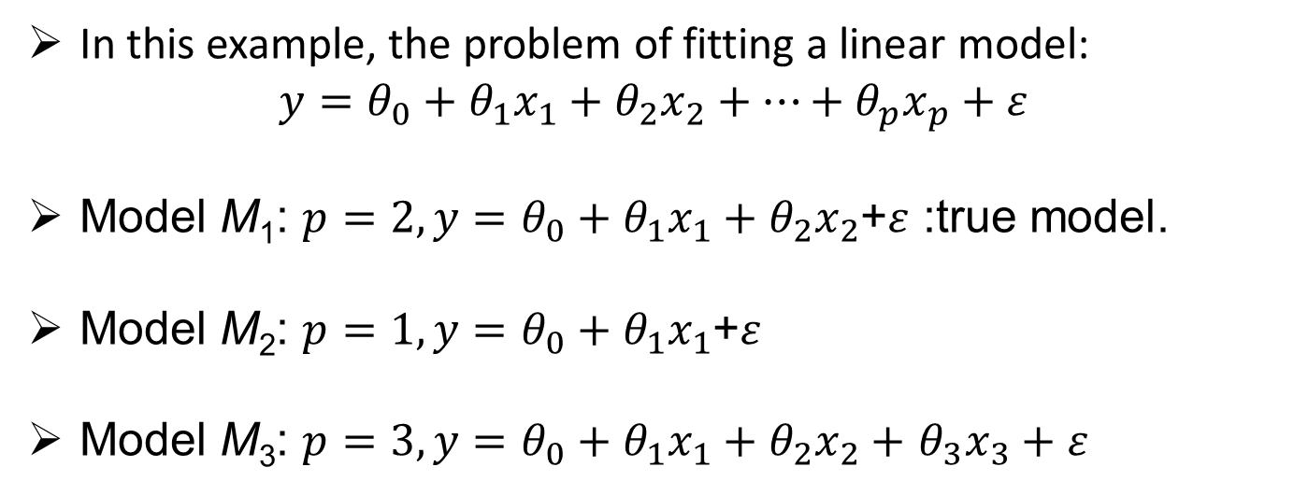
Example 1.Linear Model
In this example, the problem of fitting a linear model:
$$y=θ_{0}+θ_{1}x_{1}+θ_{2}x_{2}+⋯+θ_{p}x_{p}+ε$$
Model M₁: $p=2, y=θ_{0}+θ_{1}x_{1}+θ_{2}x_{2}$+$ε$ :true model.
Model M₂: $p=1, y=θ_{0}+θ_{1}x_{1}$+$ε$
Model M₃: $p=3,y=θ_{0}+θ_{1}x_{1}+θ_{2}x_{2}+$ $θ_{3}x_{3}+ε$

Slide 14
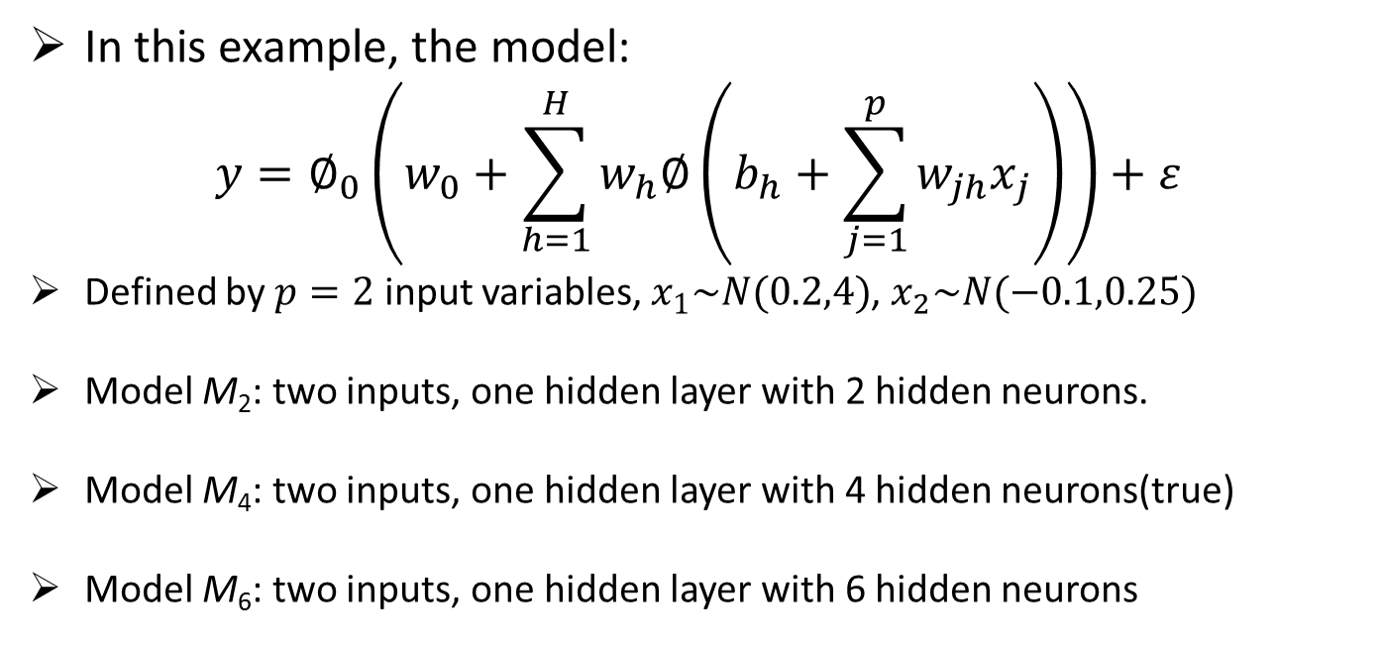
Example 2.Non-Linear Model
In this example, the model:
$$y=∅_{0}\left(w_{0}+\sum_{h=1}^{H}{w_{h}∅\left(b_{h}+\sum_{j=1}^{p}{w_{jh}x_{j}}\right)}\right)+ε$$
Defined by $p=2$ input variables, $x_{1}\sim N(0.2,4)$, $x_{2}\sim N(−0.1,0.25)$
Model M₂: two inputs, one hidden layer with 2 hidden neurons.
Model M₄: two inputs, one hidden layer with 4 hidden neurons(true)
Model M₆: two inputs, one hidden layer with 6 hidden neurons

Slide 15
Example 3.Non-Linear Model with Real Data
This example uses a model with 22 input variables, 2 hidden layers(the first one with 26 neurons, the other one with 40 neurons).
Model M₄₀: 22 inputs, two hidden layers with, respectively, 26 and 40 hidden neurons.
Model M₃₅: 22 inputs, two hidden layers with, respectively, 26 and 35 hidden neurons.
Model M₃₀: 22 inputs, two hidden layers with, respectively, 26 and 30 hidden neurons.

Slide 16
Drawbacks
The computer simulation time: If n or p is high, computation time can be very long even with second-order optimization techniques as BFGS, but it still remains less than computing time for empirical exploration.
The repetition of extremal data: The risk exists to select a re-sampling data set for which iterative methods will converge with difficulty. But ignoring these repetitions could introduce a bias.

Slide 17
Thank You!

